Slide 1


Incisional hernia prevention in obese population
Università di Genova, Genoa, Italy
    Italian Society of Hernia and Abdominal Wall Surgery
    Secretary of Science, EHS Board
Cesare Stabilini MD, PhD

Slide 2
2241 patients
General, Colorectal, Gynecologic, Hepatobiliary/Surgical Oncology, and Urologic Surgery
The median BMI for all patients was 34.3 kg/m²(range 30.0–59.1)
CT scan at 1 yr
59% incisional hernia
15% underwent repair

Slide 3
IH models
most commonly included factor
  BMI
  surgical approach (laparotomy or laparoscopy)
  history of smoking
  ethnicity
  Emergency operation (OR 4.65; 3.90 - 5.55)
Level of evidence included in the score according to GRADE: very low
World J Surg (2022) 46:2984–2995

Slide 4
Incisional hernia occurence
METHOD
193 pts analyzed retrospectively (CRCA resections open and LAP)
Preoperative CT scan – evaluation of visceral fat (cm³)
OUTCOMES
No strong association between visceral fat and BMI
IH incidence positively correlates with visceral fat and total body fat
Visceral obesity increases 4 times the risk of SSI and IH
Dis Colon Rectum 2015; 58: 220–227

Slide 5
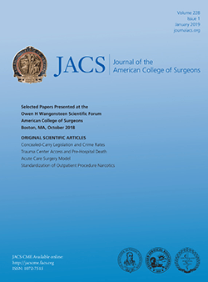
costs
500 pts submitted to open AWR (PCMs: diabetes, smoke,obesity)
scenario | No PCM | 1 PCM | 2+PCM
Total no complications | 31.787 | 41.910 | 65.453
Total with complication | 55.443 | 67.234 | 80.660
Total with SSO | 55.443 | 62.390 | 75.408
Total with mesh infection | - | 134.238 | 160.483
Weight loss | percent | Total cost
Not indicated | 75.4% | 19.600 $
Indicated but failed | 17.2% | 27.300 $
obtained | 7.4% | 17.200 $

Slide 6
factors for IH occurrence
IH are the result of inadequate early healing of the myofascial abdominal wall
IH are influenced by a combination of factors:
co-morbidities, genetics, anatomy, health-related behaviours, immunosuppressive medication, surgical technique, soft tissue healing, and SSI.
risk varies significantly across procedures and specialties
risk factors for IH impairing wound healing:
SSI OR 8.55 (95%CI 1.54 - 47.5),
diabetes OR 6.68 (95%CI 2.02 - 22.0)
smoking OR 3.93 (95%CI 1.82 - 8.49)
COPD HR 2.35 (95%CI 1.44 - 3.83),
obesity HR 1.74 (95%CI 1.04 - 2.91)
immunosuppression OR 2.5 (95%CI 1.5 - 4.2)
Franchi M, Obstet Gynecol 2001;97:696–700
Sorensen LT, Arch Surg 2005;140:119–123
Goodenough CJ, J Am Coll Surg 2015;220:405–413
Montalti R, Liver Transpl 2012;18: 188–194

Slide 7
Most of the patients in our series of IH repair are obese
AWR in obese cohort is costly and has high morbidity
BMI and visceral fat are well known risk factors for incisional hernia
Obese patients have high risk of incisional indipendently of surgical indications
Obese patients should be targeted for IH prevention

Slide 8
Possible preventive strategies
laparoscopic surgery
Prevention of SSIs
Technichal prevention
  Type of incision
  Type of closure
  Mesh augmentation

Slide 9
laparoscopy

Slide 10
Suture vs non suture
Obese patients
68 studies analyzed - 31.516 patients
Various bariatric procedures
Increasing accurracy of evaluation increases the detection rate 16.22 vs 1.37%, p = 0.06
Increasing f-up duration increases number of incisional hernia 4.59 vs 0.8%, p = 0.023
Increasing BMI categories increases the rate of incisional hernia 5.26 vs 0.50%, p = 0.015
fascia closure 1.13% vs no fascia closure 0.77%
Increasing rate of IH with increasing size of trocar access (>10mm)
Pooled incidence of TROCAR SITE HERNIA 3,2%

Slide 11
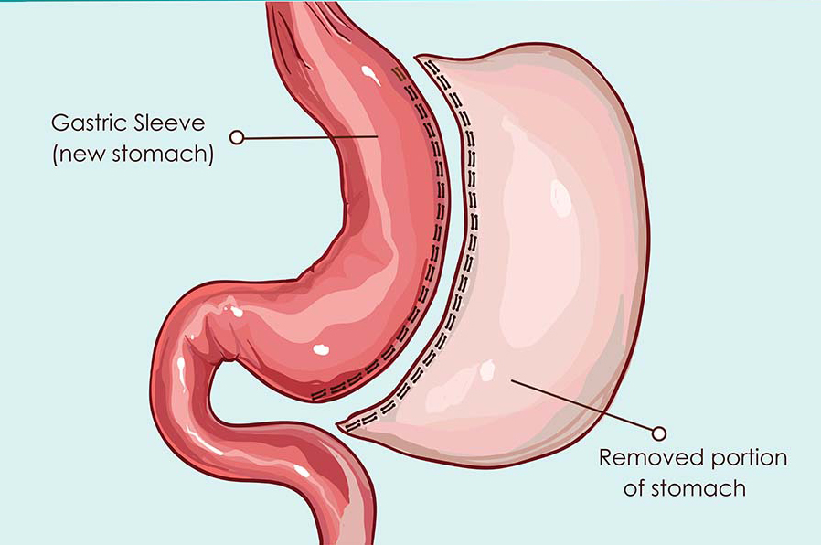
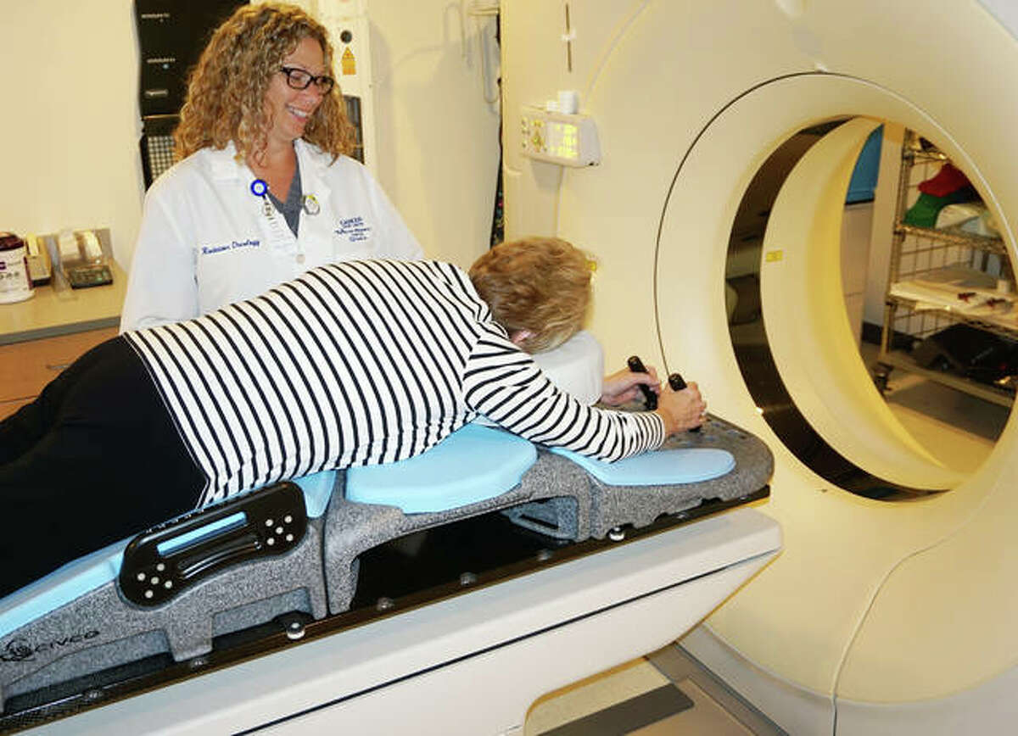
79 patients operated
CT scan with abdominal ring on the trocar sites
37 months f-up
21,5% of patients with TSH

Slide 12
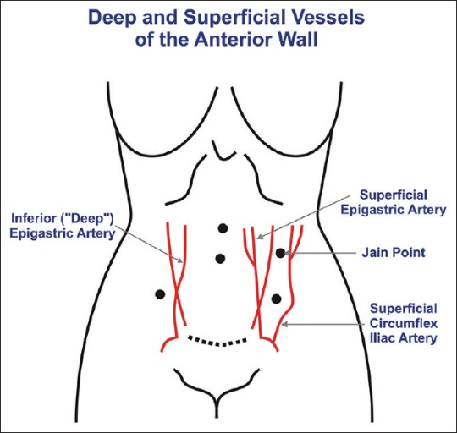

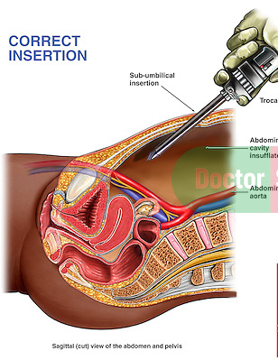

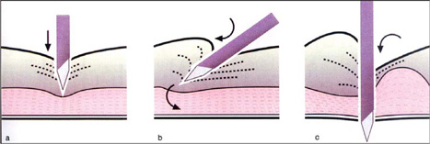
Entry technique
Alterantive mechanisms of IH formation
Traumatizing maneuvers when trying to stop bleeding
infection
Cochrane Database Syst Rev. 2019 Jan 18;1(1):CD006583
Angle of entry
No difference among techniques (open, Verres, direct trocar) of induction of pneumoperitoneum concerning primary and secondary outcomes
Sparse number
Insufficient quality of evidence
stretching

Slide 13
Midline trocar hernia are at higher risk
Neglectable risk for 5mm
No difference in fascial closure vs non closure
18,533 from 19 papers
mean follow-up period of 22.50 ± 1.76 months
overall trocar site hernia rate was 0.104%
Heterogeneity 29%
Higher IH rate for bladed trocars

Slide 14
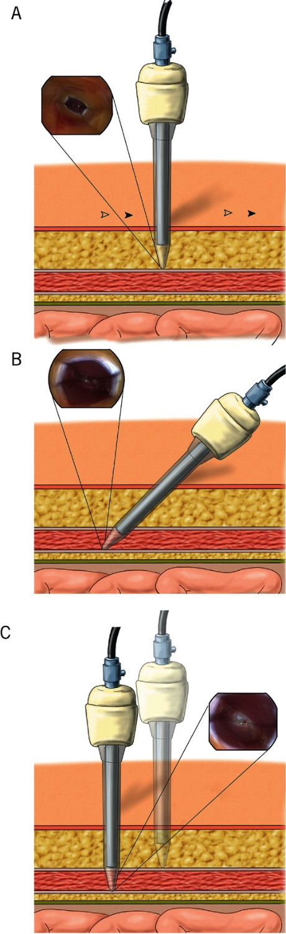
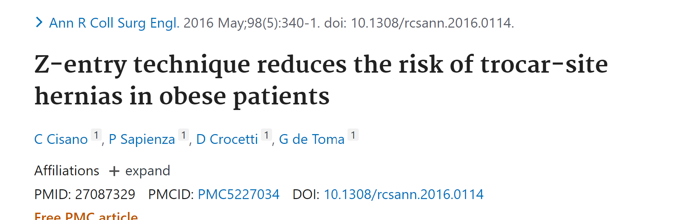
The distance between two openings in the muscular fascia reduces the risk of trocar-site hernias because of the angled path through the abdominal wall.

Slide 15
RCT – double blinded
Population: obese patients undergoing Rygbp or SG for morbid obesity
35 patients treatment NEOCLOSE, 35 pts control SUTURE PASSER
F-up with US
treatment
 | neoclose | control
Primary outcomes
Closure time | 20,2’ | 30,0’
Pain 1week | 0,3(SD 0,8) | 0,9 (SD 1,4)
Secondary outcome
Incisional hernia 1 yr | 0 | 0
control

Slide 16
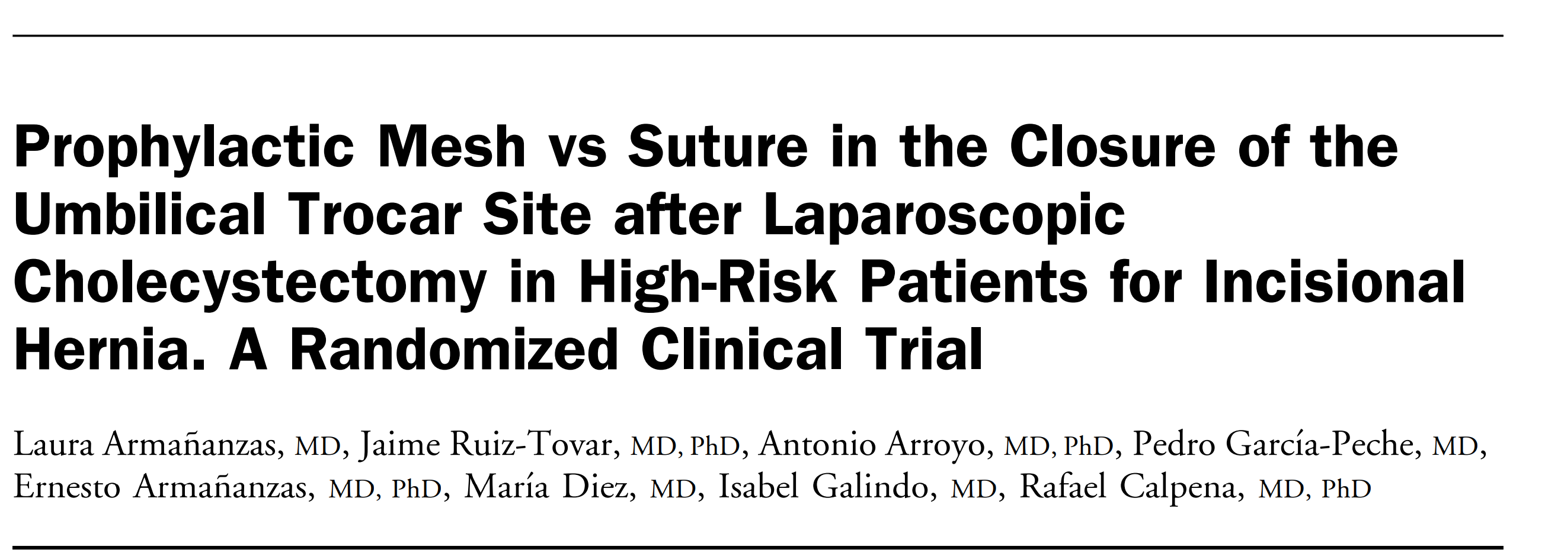
RCT
47 Group A (suture non-abs) vs 45 Group B (intraperitoneal mesh – V patch)
High risk patients for TSH
  age 65 years and older, diabetes mellitus, chronic pulmonary disease, and obesity (ie, body mass index 30 kg/m2 )
Visit early postoperative; 1-6-12 months
 | Group A (suture) | Group B (mesh) | OR (95%CI)
TSH | 31,9% | 4.4% | 10.1; (2.15 - 47.6)
Wound Infection rate | 8,5% | 0% | 2.04; (1.7-2.5)
VAS | 3 (1-6) | 2 (0-6)
Complications | similar | similar
Operative time | 71,4±25,2 | 69,2±26,7
LOS | 2 (1-5) | 2 (1-11)

Slide 17
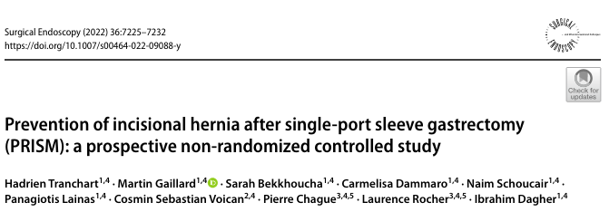
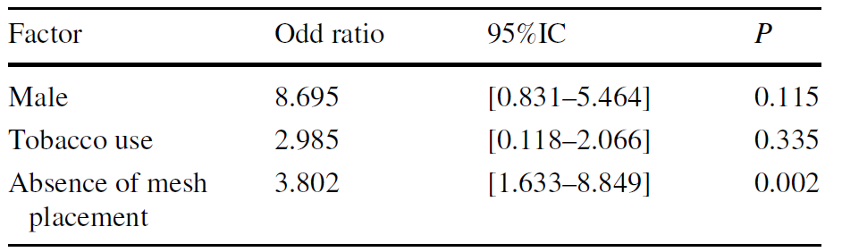
Sample size
Inclusion criteria
3 groups of closure
suture without mesh
suture with permanent mesh placement
suture with absorbable mesh placement
Primary outcome
Radiological IH rate 1year postoperatively
255 consecutive patients undergoing LAP SG
BMI >45 kg/m2
IH rates
Suture 20%
Reabsorbable mesh 7.1%
Permanent mesh 5.1%

Slide 18
SSI - prevention

Slide 19
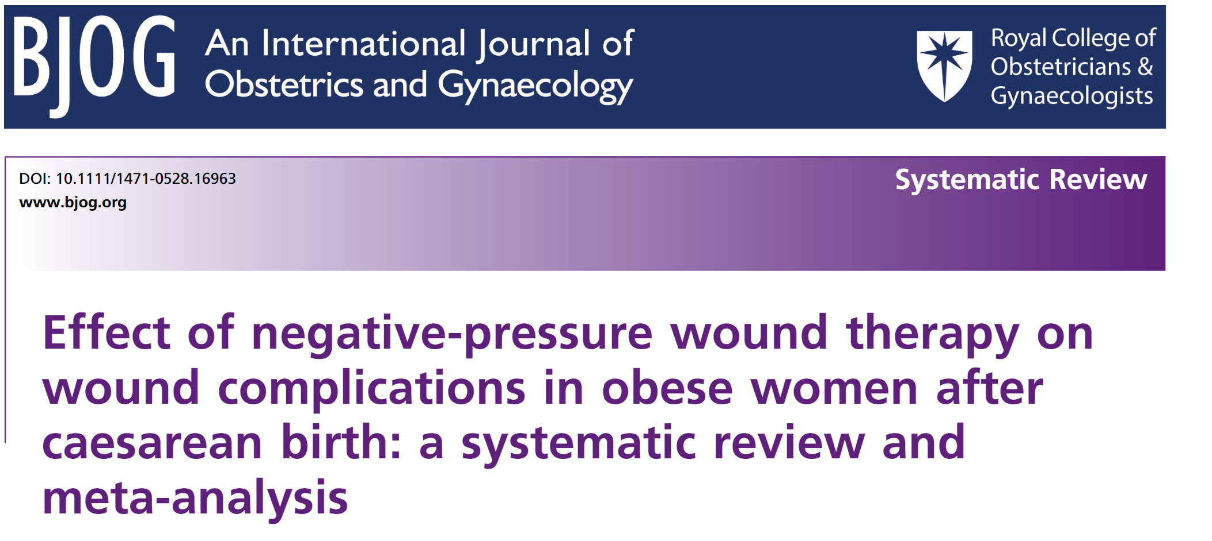
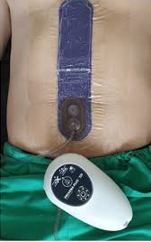
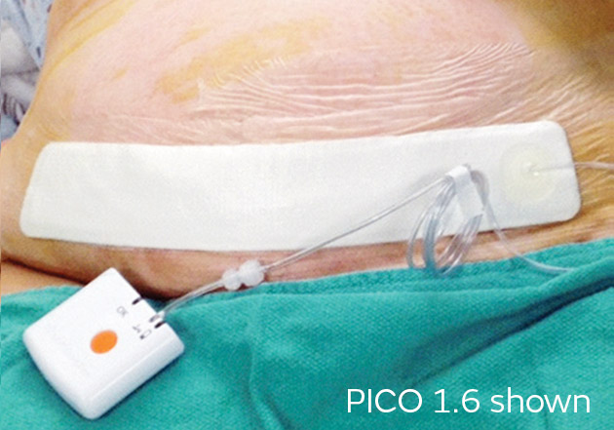
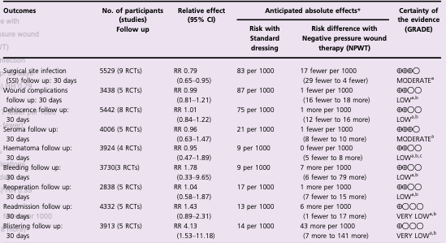
10 RCTs - 5583 patients
Obese women after cesarean section
Intervention PICO or Prevena
Comparison standard wound dressing
Duration of tratment 3-7 days
LOWER
Surgical site infections
HIGHER
blistering
Gillespie BM, BJOG. 2022 Jan;129(2):196-207.

Slide 20
Laparotomy closure – current strategy
Small bites
Primary mesh augmentation

Slide 21
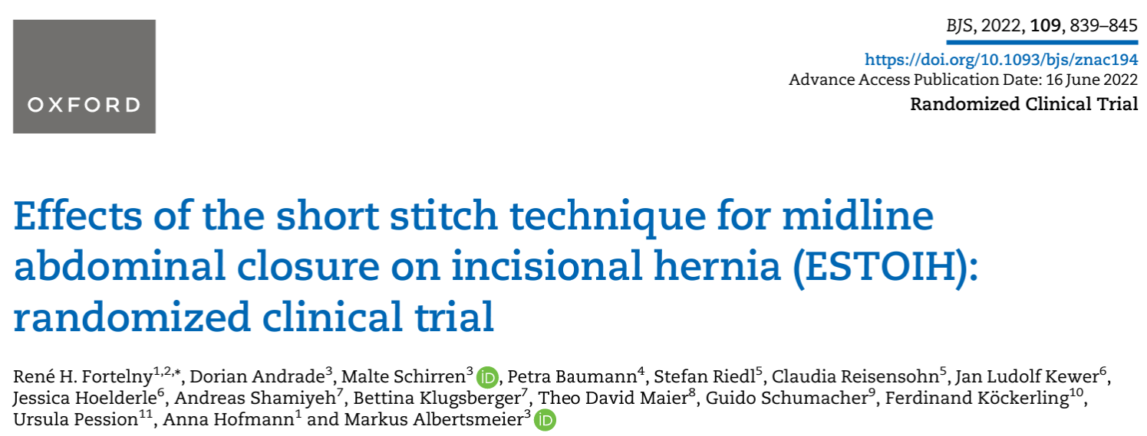
 | Long Stitch (381s) | Small Stitch (356s) | p
Suturing time | min 14 (range 13-15) | min 18 (range 17-19) | <0,001
SSI | 10,2% | 5,2% | 0,02
IH 1yr | 18,0% | 5,6% | <0,001
Arch Surg. 2009;144(11):1056-1059
 | Long Stitch (277s) | Small Stitch (268s) | p
IH 1yr | 21% | 13% | 0,0131
Lancet. 2015 Sep 26;386:1254
 | Long Stitch (210s) | Small Stitch (215s) | p
burst abdomen | 4,76% | 1,4% | 0,05
IH 1yr | 6,4% | 3,3% | NS

Slide 22
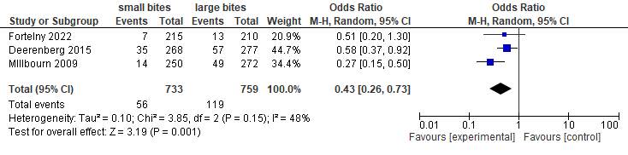
Adding ESTOIH trial the results in Meta analisis do not change
the technique can be still recommeded
No study comparing small bites vs large bites directly in obese population
Obese patients in major trial are mixed, no definitive recommendation can be done
obese patients are a high risk category, probably small bites could be suboptimal

Slide 23
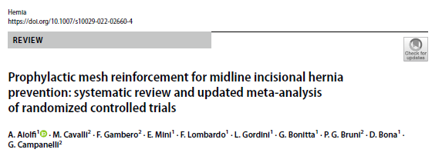
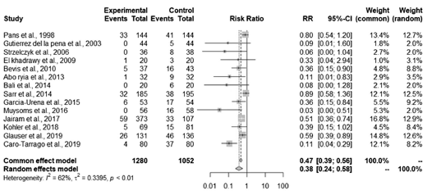
Incisional hernia
2332 patients included
1280 (54.9%) underwent PMR vs 1052 (45.1%) PSC.
BMI 23.5 to 51 kg/m²
52.9% females
High heterogeneity:
  Mesh position
  Suture technique
  Mesh material
  F-up
seroma
Surgical Site Infection

Slide 24
Small bites
Effective in reducing incisional hernia rate in low risk patients
Primary mesh augmentation
Effective in reducing incisional hernia rate in higher risk patients
in the obese population?

Slide 25
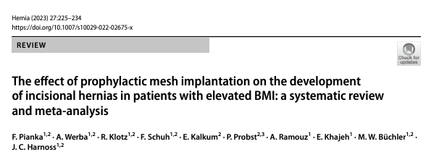
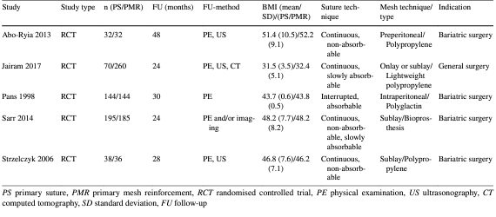
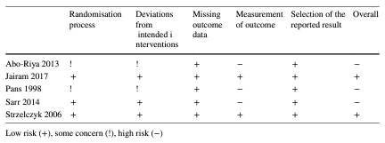
Outcomes
Effectiveness of Profilactic Mesh implantation
Safety of Profilactic Mesh Implantation
Lenght of Stay
Heterogeneity in populations
Heterogeneity in sutures
Heterogeneity in mesh position and type

Slide 26
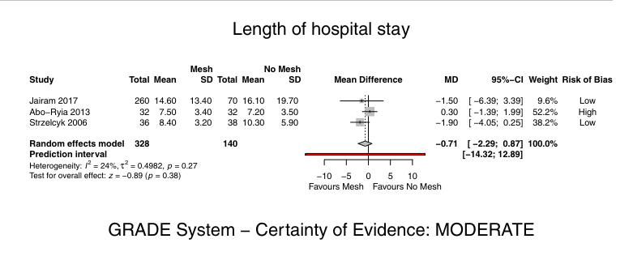
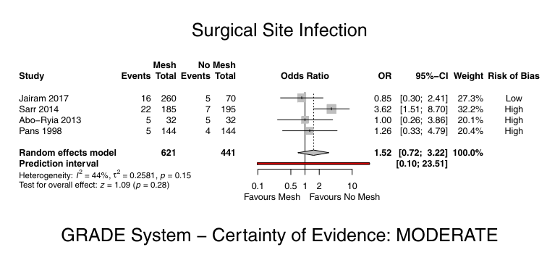
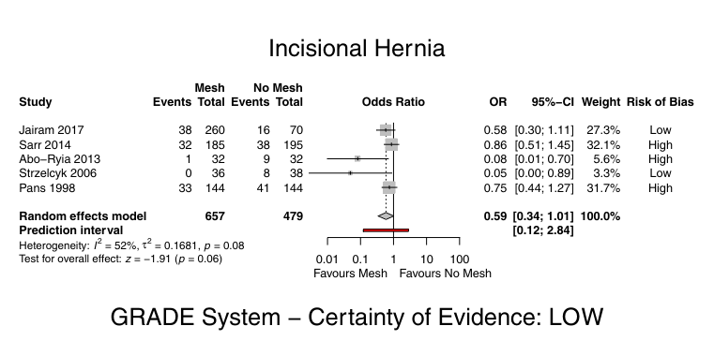
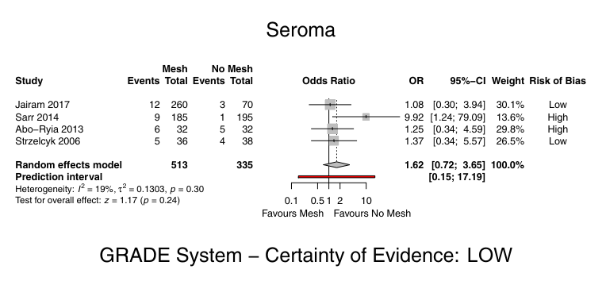
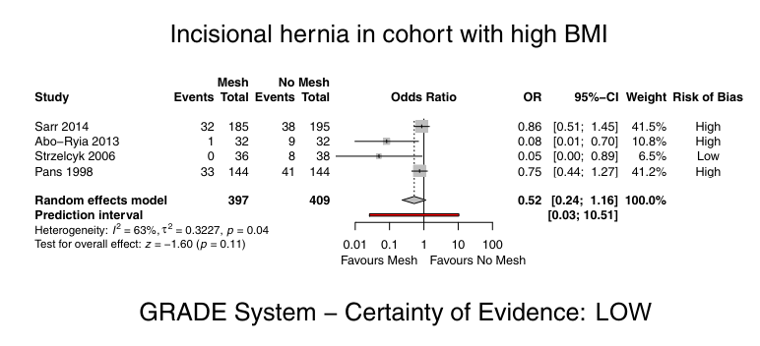
 | Mesh | Suture | p
IH incidence | 14% | 23% | NS
Seroma | 6% | 4% | NS
SSI | 8% | 5% | NS
Lenght of Stay | 10 days | 11 days | NS

Slide 27
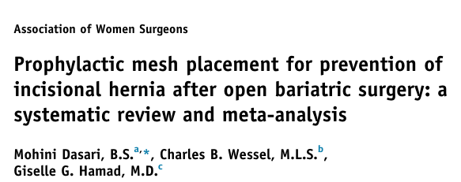
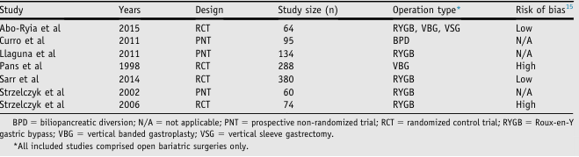
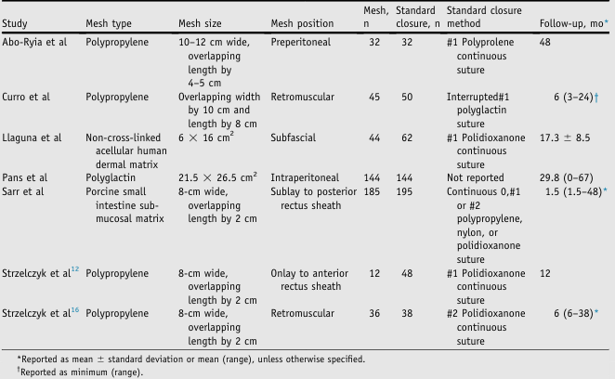
7 studies (4 RCTs)
1,067 patients,
498 (46.7%) prophylactic mesh
 | IH | SSIs
overall | 0,30 (0,13-0,68) | 1,86 (0,64 – 5,40)
RCT subset | 0,52 (0,24 – 1,16) | 2,05 (0,59 – 7,14)

Slide 28
conclusions
Obesity is a know higher risk factor for incisional hernia occurrence
Incisional hernia repair has major costs and complications
A specific preventive strategy for incisional hernia should implement
  Higher use of laparoscopy and mesh augmentation for higher risk trocar accesses (midline, SILS)
  Strict control over SSIs
  Mesh implantation in a shared decision making with patients

